Slide 1
Symbian Operating System
A mobile OS made based on C++
Suyash 21137
Shubham 21118
Sanyam 21119

Slide 2

Introduction
Symbian is a discontinued mobile operating system and computing platform designed for smartphones.
Symbian was used by old smartphones such as Samsung, Motorola, Sony Ericsson and Nokia, well before android and ios.

Slide 3
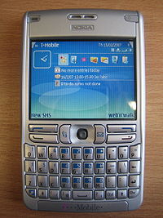
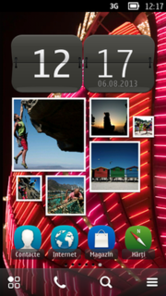
Introduction (contd.)
Symbian OS was written using C++ using Symbian software coding standards.
Symbian OS was released exclusively on ARM processors, although an unreleased x86 port existed.
Symbian OS was the most popular smartphone OS on a worldwide average until the end of 2010.
Symbian v9.1 with a S60v3 interface, on a Nokia E61.
Home screen of Nokia Belle Feature Pack 2 (last version of Symbian).

Slide 4
History of Symbian OS

Slide 5
Origin of Symbian
Symbian was originally developed as a proprietary software OS for PDA in 1998 by the Symbian Ltd. consortium.
Symbian originated from EPOC32, an operating system created by Psion in the 1990s.
In June 1998, Psion Software became Symbian Ltd., a major joint venture between Psion, Ericsson, Motorola, and Nokia.
In June 2008, Nokia acquired Symbian Ltd., and a independent non-profit organization called the Symbian Foundation was established.
Symbian OS and its associated user interfaces S60, UIQ and MOAP(S) were contributed by their owners Nokia, NTT DoCoMo, Sony Ericsson and Symbian Ltd.
The Symbian platform was officially made available as Free software in February 2010.

Slide 6
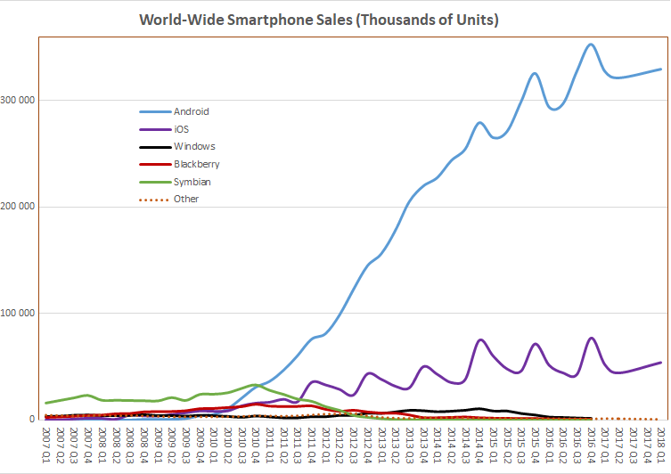
Popularity
With no major competition in the smartphone OS, Symbian reached as high as 67% of the global smartphone market share in 2006, as you can see from the figure.
Due to newer and simpler OS like android, ios etc. and lack of evolution, Symbian’s market share was dropped as low as 0.2% on Q2 of 2013.

Slide 7
Fall of Symbian
On 11 February 2011, Stephen Elop, CEO of Nokia announced a partnership with Microsoft that would see Nokia adopt Windows Phone as its primary smartphone platform and Symbian would be gradually phased out.
As a consequence, Symbian's market share fell, and application developers for Symbian dropped out rapidly.
Research in June 2011 indicated that over 39% of mobile developers using Symbian at the time of publication were planning to abandon the platform.
By 5 April 2011, Nokia ceased to make free any portion of the Symbian software and reduced its collaboration to a small group of pre-selected partners in Japan.

Slide 8
Fall of Symbian (contd. )
On 22 June 2011, Nokia made an agreement with Accenture for an outsourcing program. Accenture will provide Symbian-based software development and support services to Nokia through 2016.
About 2,800 Nokia employees became Accenture employees as of October 2011. The transfer was completed on 30 September 2011.
Nokia terminated its support of software development and maintenance for Symbian with effect from 1 January 2014.
Nokia started refusing to publish new or changed Symbian applications or content in the Nokia Store and terminating its 'Symbian Signed' program for software certification. This marks end of Symbian.
Notes:
Source code released under the EPL remains available in third party repositories

Slide 9
Exception Handling

Slide 10
Classification
Until Symbian OS v9 - non-standard exception handling
After v9 - standard exception handling
Non - standard / symbian native c++ exceptions
Symbian OS exception Handling
Standard c++ exceptions

Slide 11
Symbian OS native exception handling
Till v9
Exception - initiated by invoking leave and caught by trapping leave
When method leaves - normal path of program execution is abandoned
leave is propagated back through the call stack until it is explicitly trapped by a handler
If leave is not trapped in program, system handles it
Cleanup stack

Slide 12
Leaves / traps
user::Leave() is analogous to a C++ throw
TRAP and TRAPD are analogous to a combination of try and catch
Leave unwinds stack
If you don’t trap a leave, it will propagate
Not every leave should be trapped

Slide 13
Standard C++ Exceptions in Symbian OSv9
From v9
Two different approaches
Usage of the native leave/trap framework is unchanged
Leave mechanism is faster

Slide 14
// some code block
{
…
// try block
Try {
// perform some action that might fail, for example
// memory allocation, or file system or network operation
}
catch ( exception ) {
// handle the failure
return failure;
}
…
return success;
}

Slide 15
Standard C++ Exceptions in Symbian OSv9 (Contd.)
Standard C++ exceptions do not use a cleanup stack, therefore code that uses standard exceptions should manually ensure that memory leaks do not occur when an exception is raised
when porting standard C++ code to Symbian OS, this is an essential step toward ensuring that code written for other platforms will have robust behavior on a typical Symbian OS device

Slide 16
If you are making clone, which exception handling to choose??
The choice between Symbian native exceptions and standard C++ exceptions is best made depending on whether new code is being written or existing code is being ported.
Whichever approach is taken, the three most critical rules for error handling are:
always be ready to handle errors
handle errors without losing data
handle errors without leaking memory / resource

Slide 17
Software Development

Slide 18
Qt
As of 2010, the SDK for Symbian is standard C++, using Qt. It can be used with either Qt Creator, or Carbide.
Symbian C++
As Symbian OS is written in C++ using Symbian Software's coding standards, it is possible to develop using Symbian C++, although it is not a standard implementation.
Deployment
Once developed, Symbian applications need to find a route to customers' mobile phones. They are packaged in SIS files which may be installed over-the-air, via PC connect, Bluetooth or on a memory card.

Slide 19
Architecture

Slide 20
The Symbian OS System Model contains the following layers :
UI Framework Layer: Application Services Layer (Ex: Java ME)
Basic Services Layer
Kernel Services and hardware Interface Layer
OS Services Layer:
Generic OS Services
Communication Services
Multimedia and Graphics Services
Connectivity Services

Slide 21
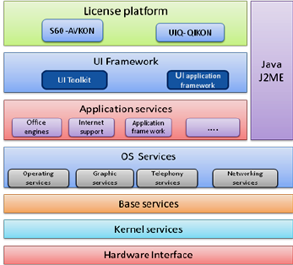

Slide 22
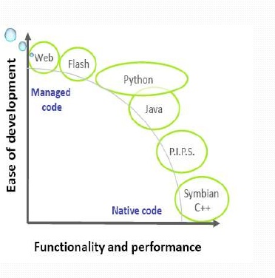
Choice of development of language
Symbian C++ is most powerful.
Provides greatest access to Capabilities of OS
Fastest because it runs on Natively Compiled Code

Slide 23
Some Cool Facts about Symbian OS :
Symbian OS targets a very specialized device domain: that of communications-centric mobile devices generally, and of mobile phones in particular.
On such devices, the possibilities for resource allocations to fail are much greater than in big systems of the kind the C++ language originally targeted (telephone exchanges, for example).

Slide 24
Android vs. Symbian
Android was made using Java Programming Language.
Android is designed around touch capable devices.
Android was more resource heavy as compared to Symbian.
Android got frequent updates due to which it always stayed ahead of competition.
Symbian was made using C++ Programming Language.
Symbian was designed around keypad devices.
Symbian was lightweight and often needed less computing power.
Symbian is somewhat outdated and didn’t get much updates over time.

Slide 25

“One of the significant advantages that will not be forgotten is the long battery life offered by the devices.”
Team Symbian

Slide 26
References
Exception Handling in Symbian OS Ben Morris Published by the Symbian Developer Network
https://en.wikipedia.org/wiki/Symbian
https://en.wikipedia.org/wiki/Mobile_operating_system
https://www.researchgate.net/figure/Architecture-of-Symbian-Mobile-OS_fig1_280310649

Slide 27

Thanks!

